Slide 1
The Model Context
Protocol (MCP)
BUILDING SCALABLE AGENTIC SYSTEMS
Korey Stegared-Pace
Senior AI Cloud Advocate, Microsoft

Slide 2
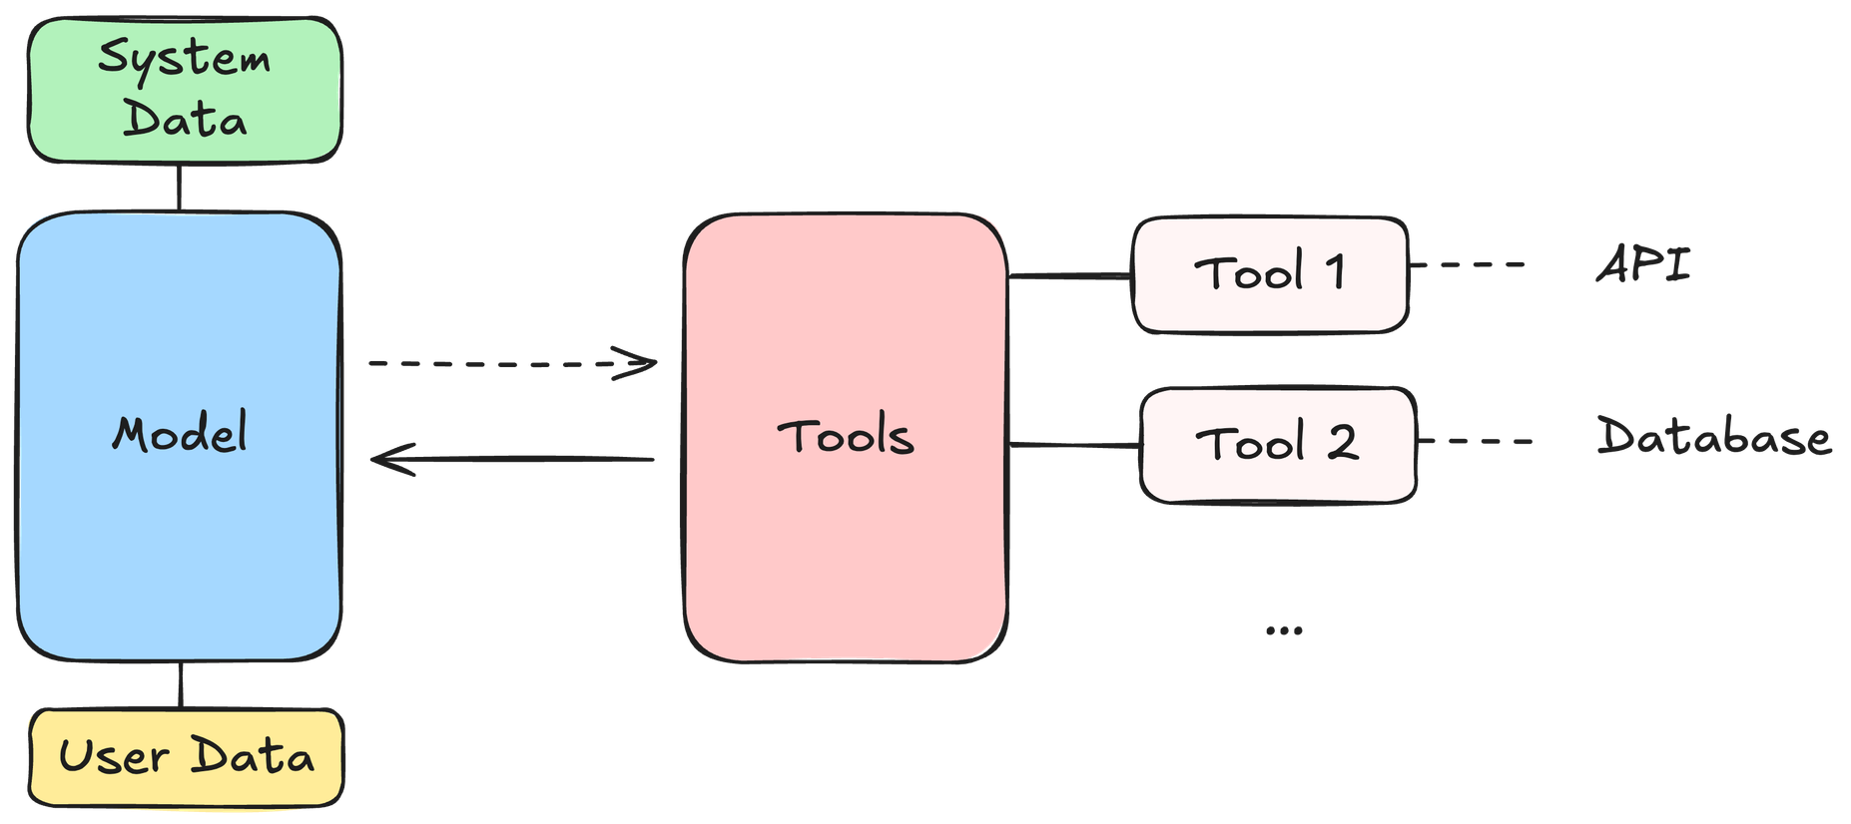
Agent interoperability: the state-of-play
BUILDING SCALABLE AGENTIC SYSTEMS

Slide 3
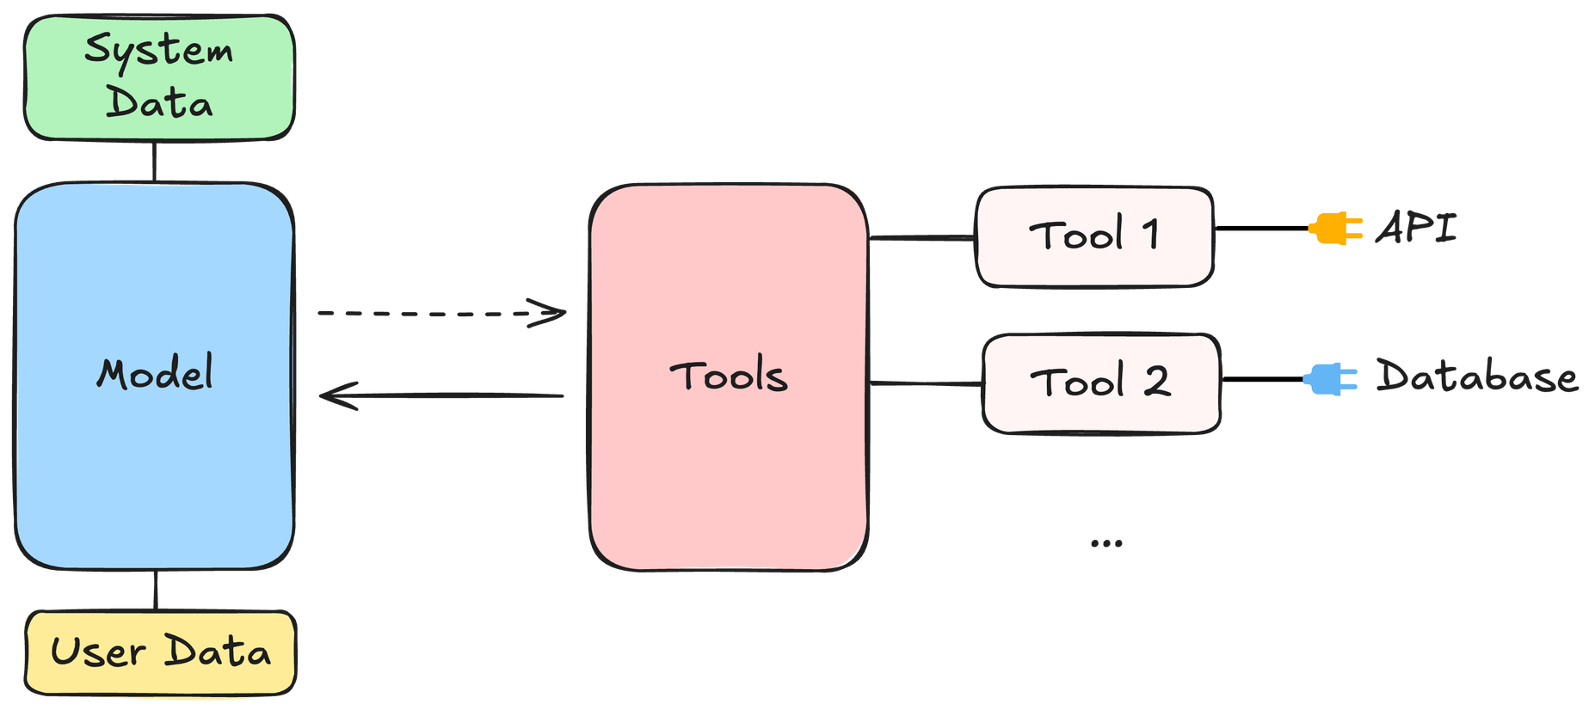
Agent interoperability: the state-of-play
BUILDING SCALABLE AGENTIC SYSTEMS

Slide 4
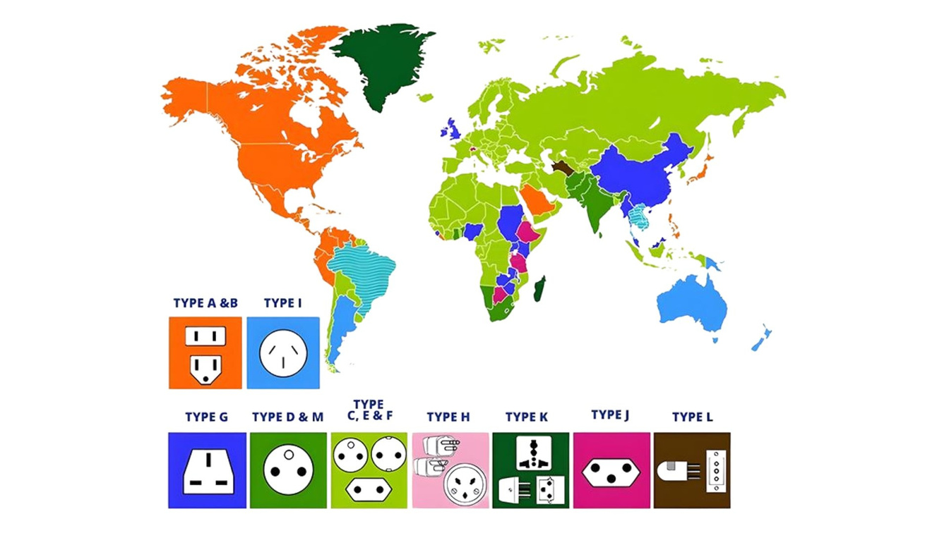
Sockets/power outlets from around the world
1
Image Credit: Xstron
BUILDING SCALABLE AGENTIC SYSTEMS

Slide 5
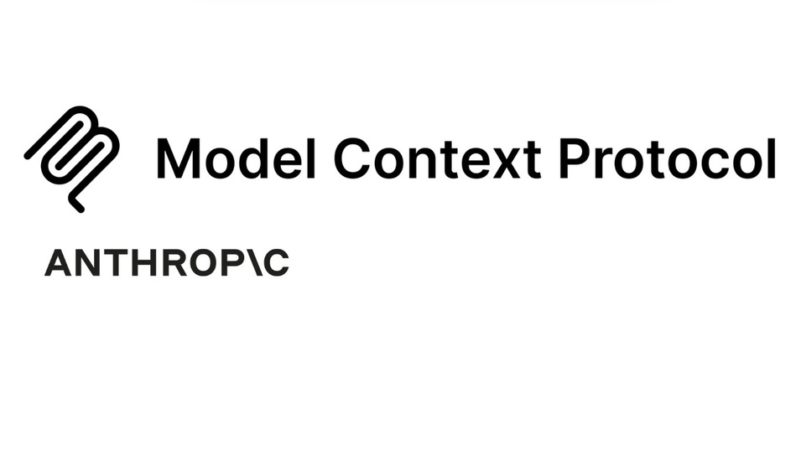

Model Context Protocol (MCP)
Universal open standard for connecting AI with data!
BUILDING SCALABLE AGENTIC SYSTEMS

Slide 6
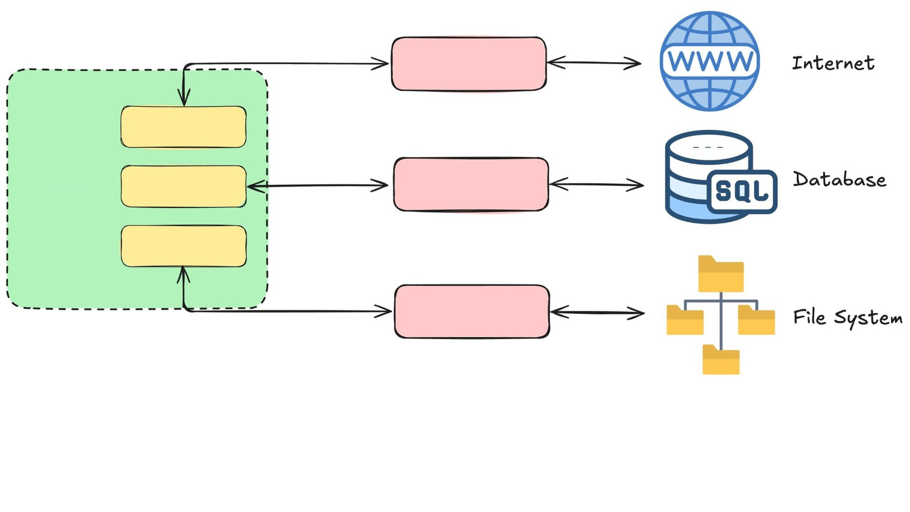
The MCP architecture
BUILDING SCALABLE AGENTIC SYSTEMS

Slide 7
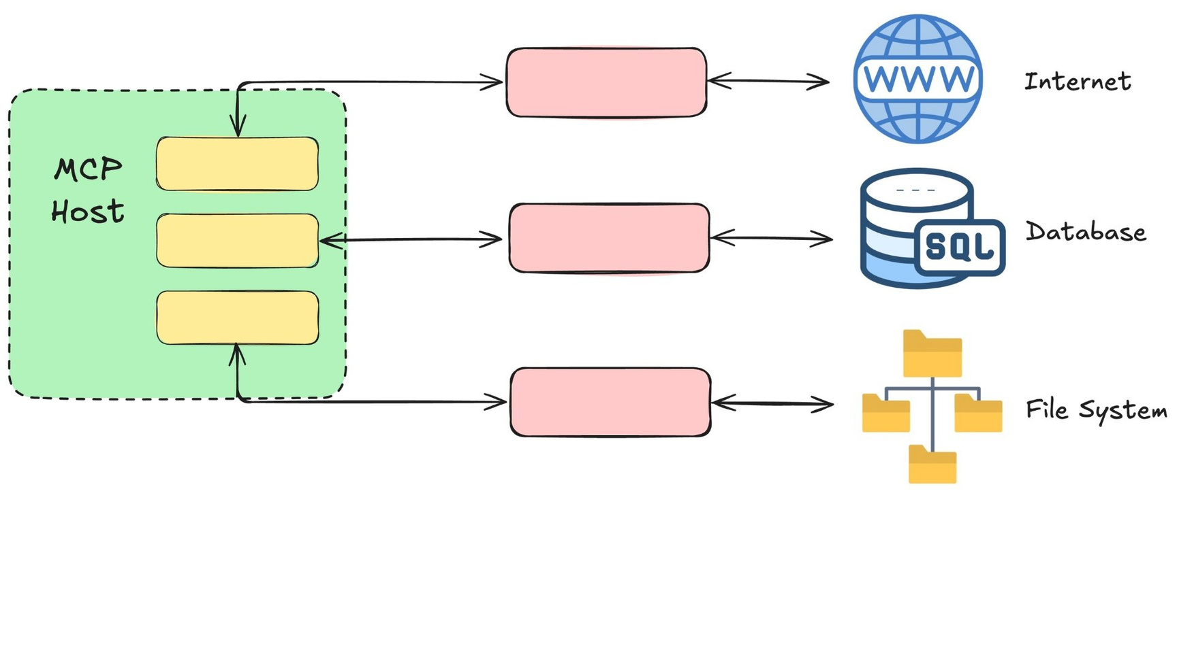
The MCP architecture
BUILDING SCALABLE AGENTIC SYSTEMS

Slide 8
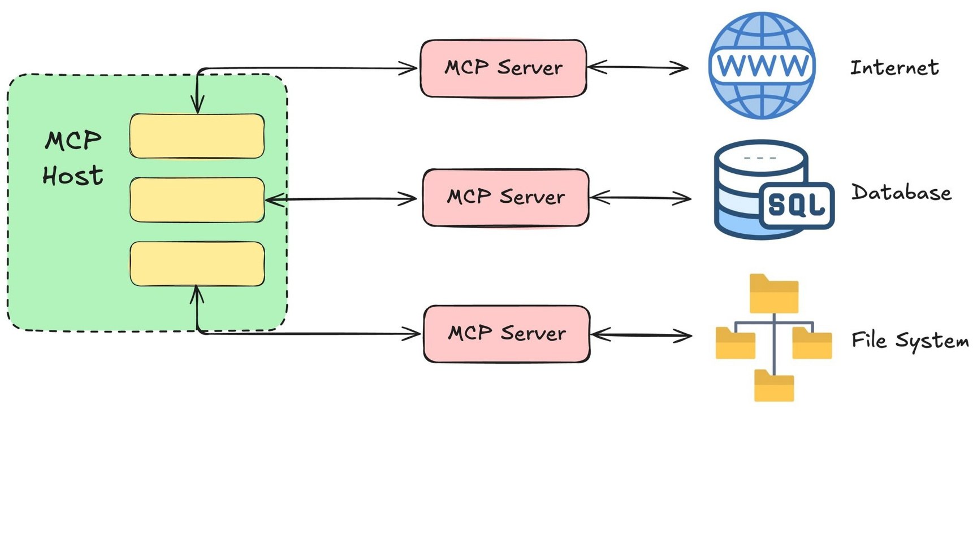
The MCP architecture
BUILDING SCALABLE AGENTIC SYSTEMS

Slide 9
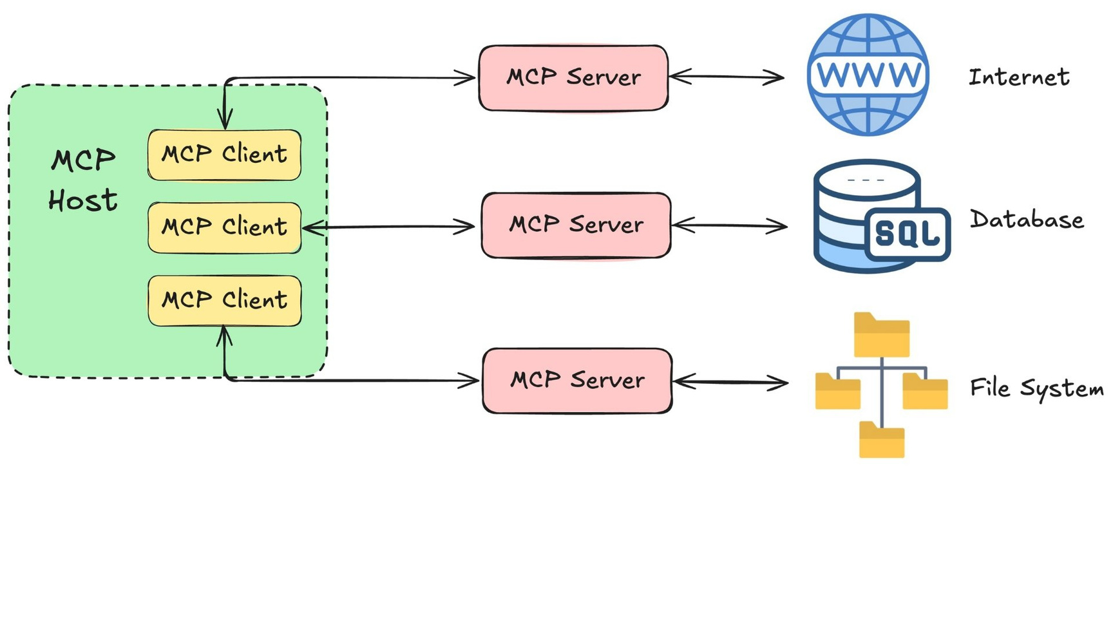
The MCP architecture
BUILDING SCALABLE AGENTIC SYSTEMS

Slide 10
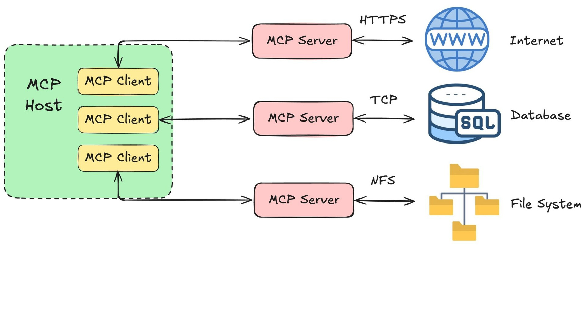
The MCP architecture
BUILDING SCALABLE AGENTIC SYSTEMS

Slide 11
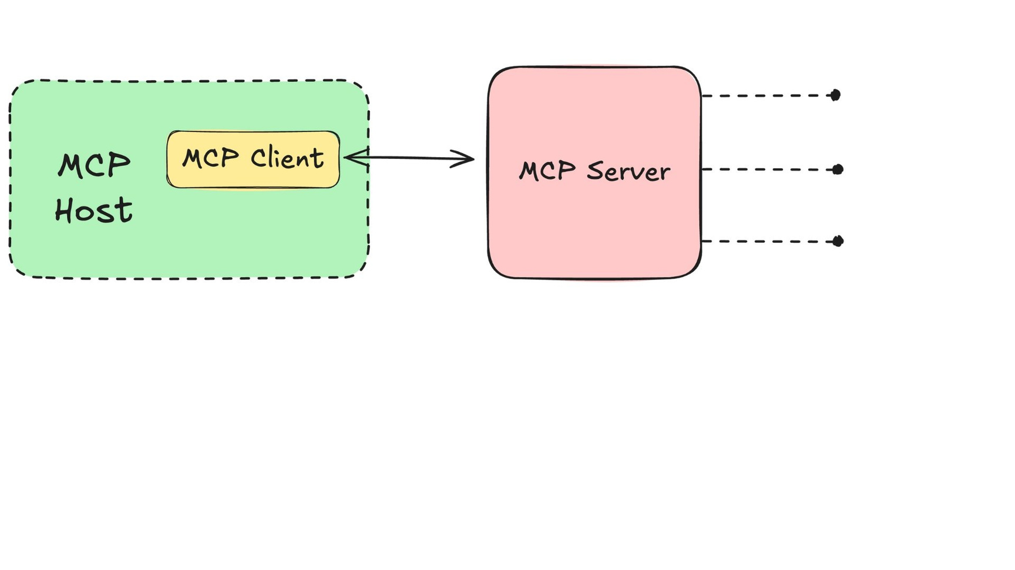
MCP servers
BUILDING SCALABLE AGENTIC SYSTEMS

Slide 12
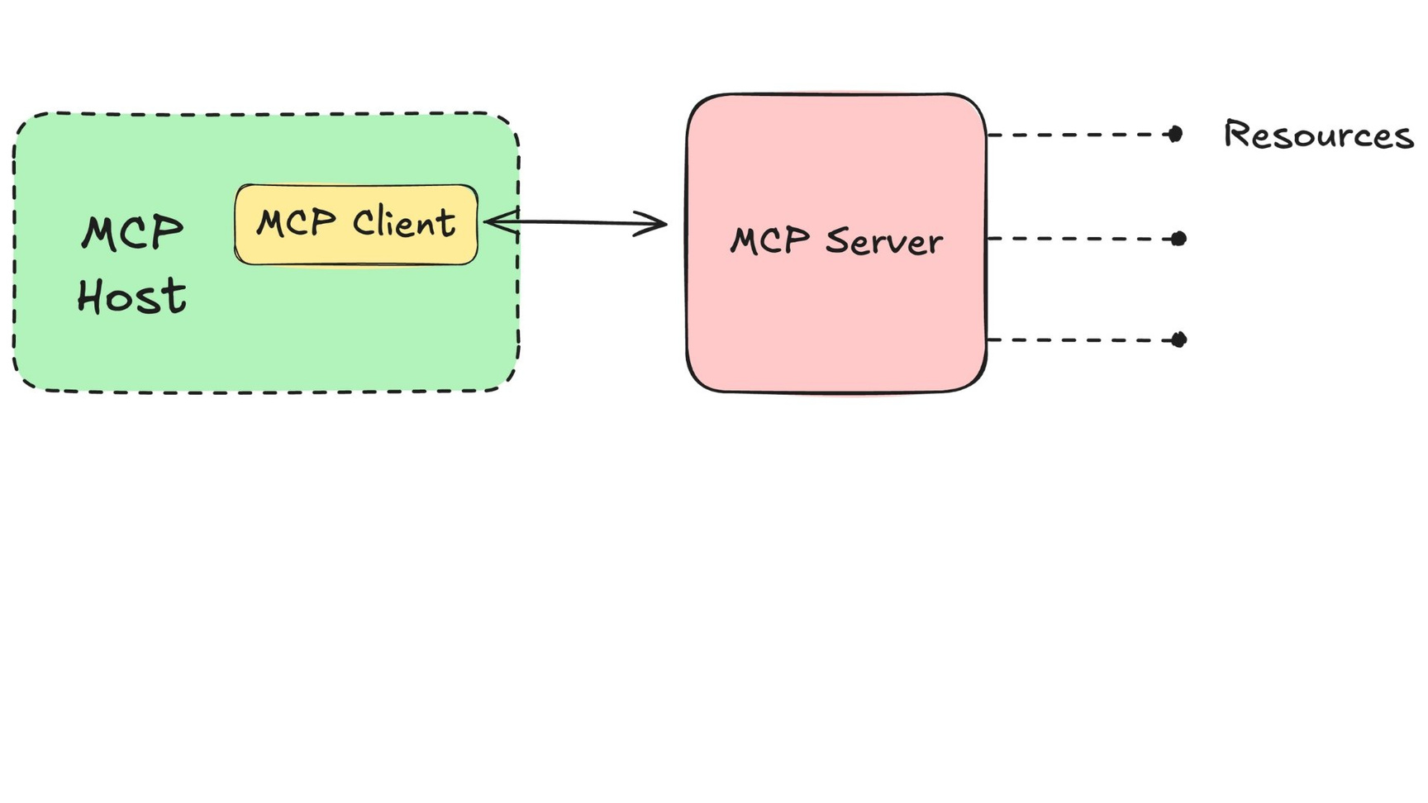
MCP servers
BUILDING SCALABLE AGENTIC SYSTEMS

Slide 13
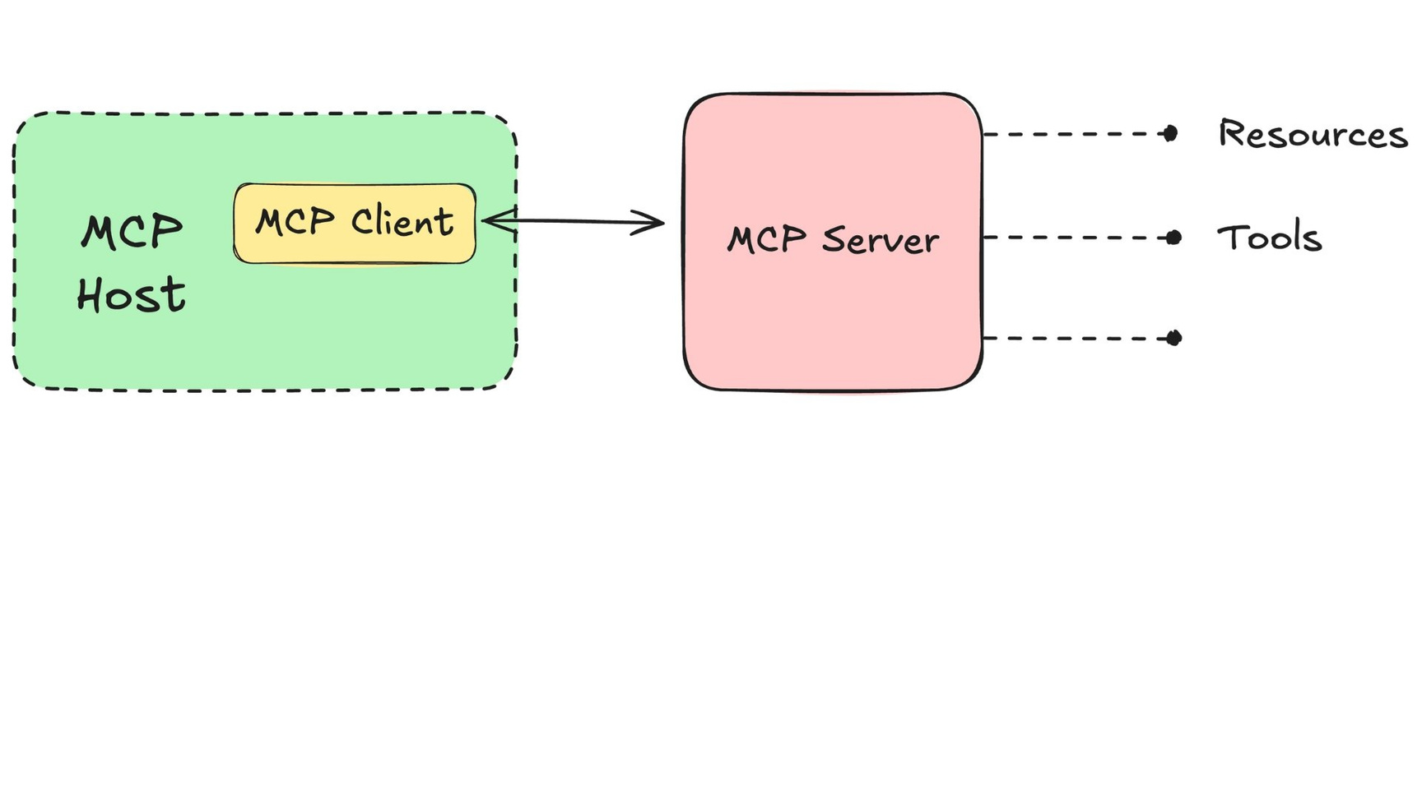
MCP servers
BUILDING SCALABLE AGENTIC SYSTEMS

Slide 14
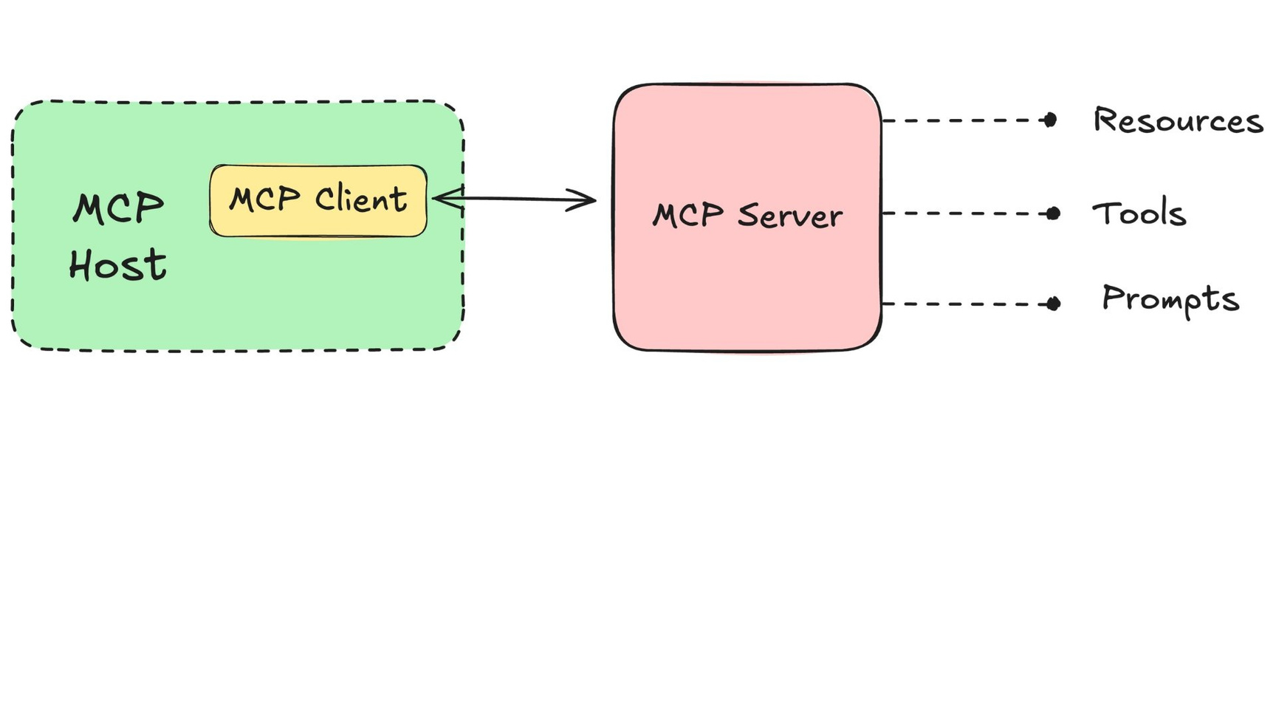
MCP servers
BUILDING SCALABLE AGENTIC SYSTEMS

Slide 15
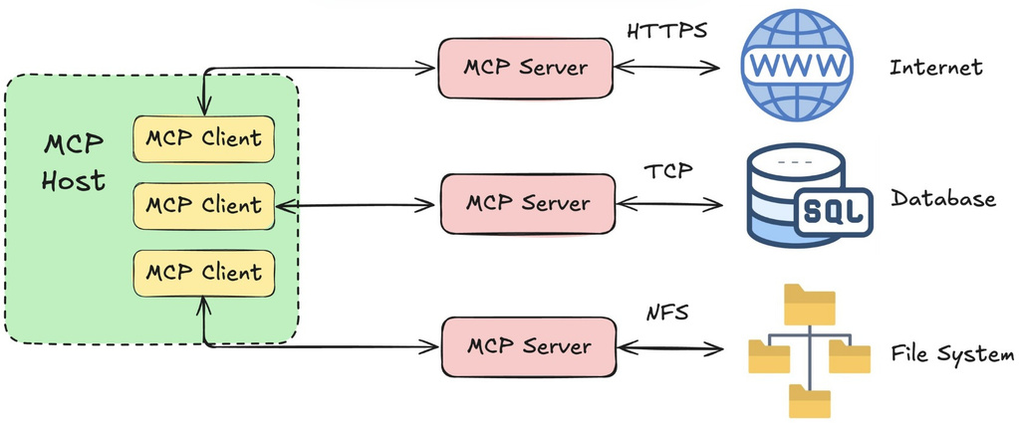
MCP
No framework
→Standard for connecting AI and data
→Customintegrationsfor each data source
Dynamic tool discovery ("integrate once") LLM-agnostic
Standardized security
Tools need to be statically coded
Often refactoring needed for different LLMs Tool-specific keys and authentication mode
BUILDING SCALABLE AGENTIC SYSTEMS

Slide 16
The Agent-to-Agent
(A2A) Protocol
BUILDING SCALABLE AGENTIC SYSTEMS
Korey Stegared-Pace
Senior AI Cloud Advocate, Microsoft

Slide 17
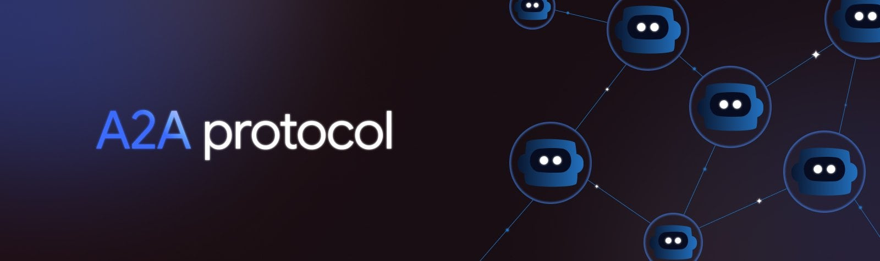
Developed by Google
Enable
multi-agent collaboration
Vendor- and tool stack-agnostic
BUILDING SCALABLE AGENTIC SYSTEMS

Slide 18
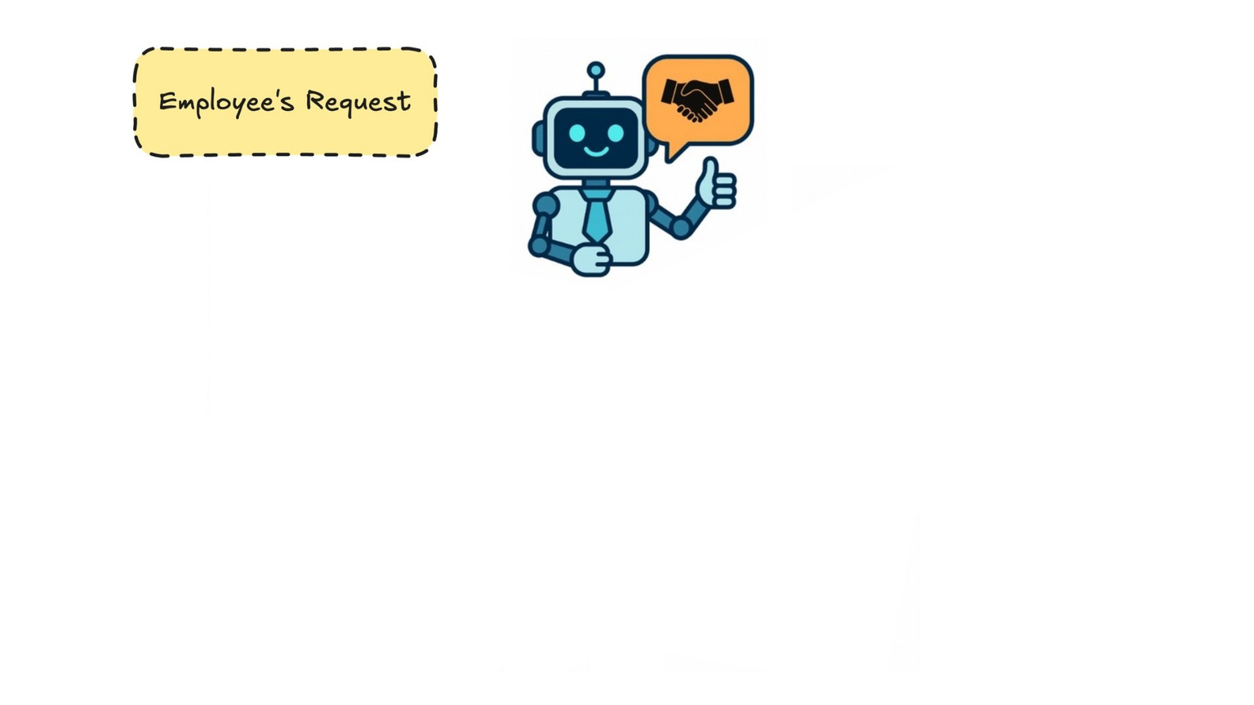
Example: Corporate travel
BUILDING SCALABLE AGENTIC SYSTEMS

Slide 19
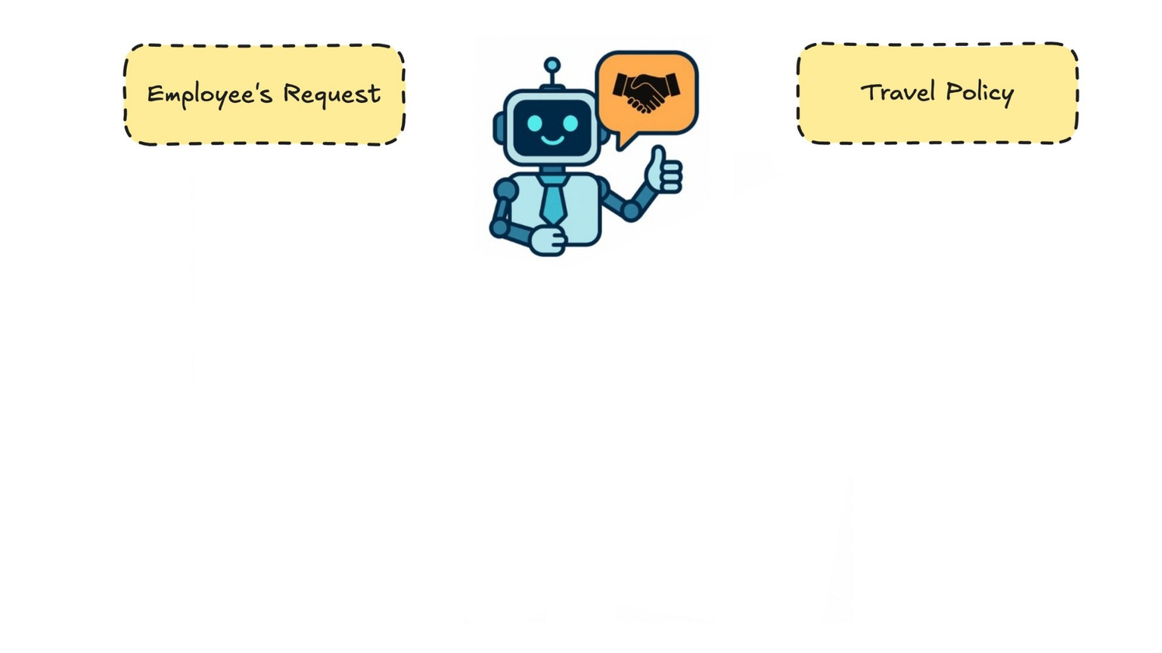
Example: Corporate travel
BUILDING SCALABLE AGENTIC SYSTEMS

Slide 20
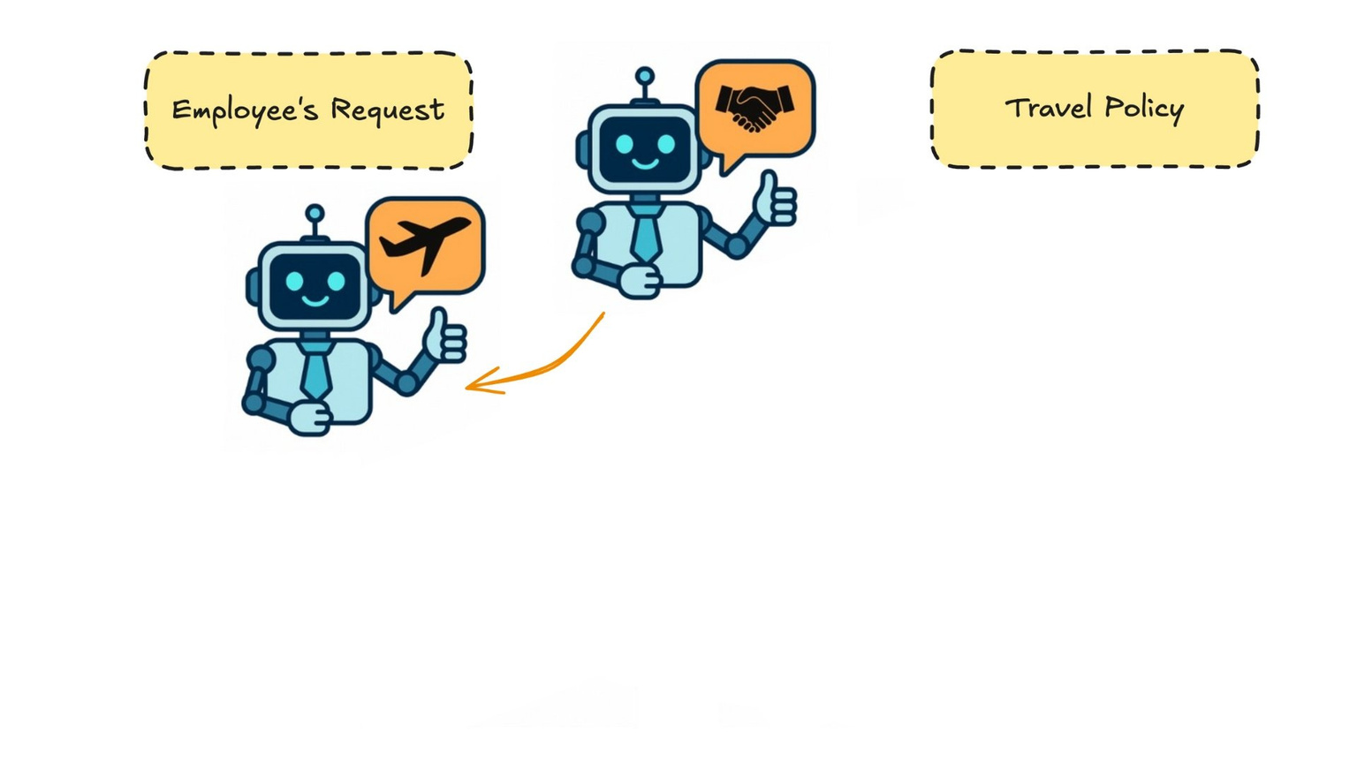
Example: Corporate travel
BUILDING SCALABLE AGENTIC SYSTEMS

Slide 21
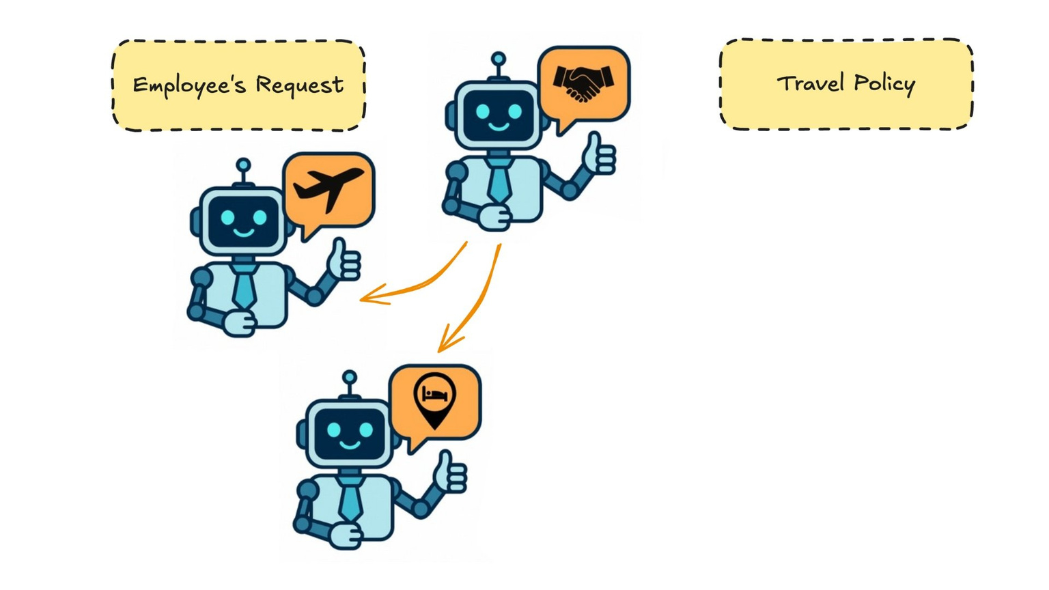
Example: Corporate travel
BUILDING SCALABLE AGENTIC SYSTEMS

Slide 22
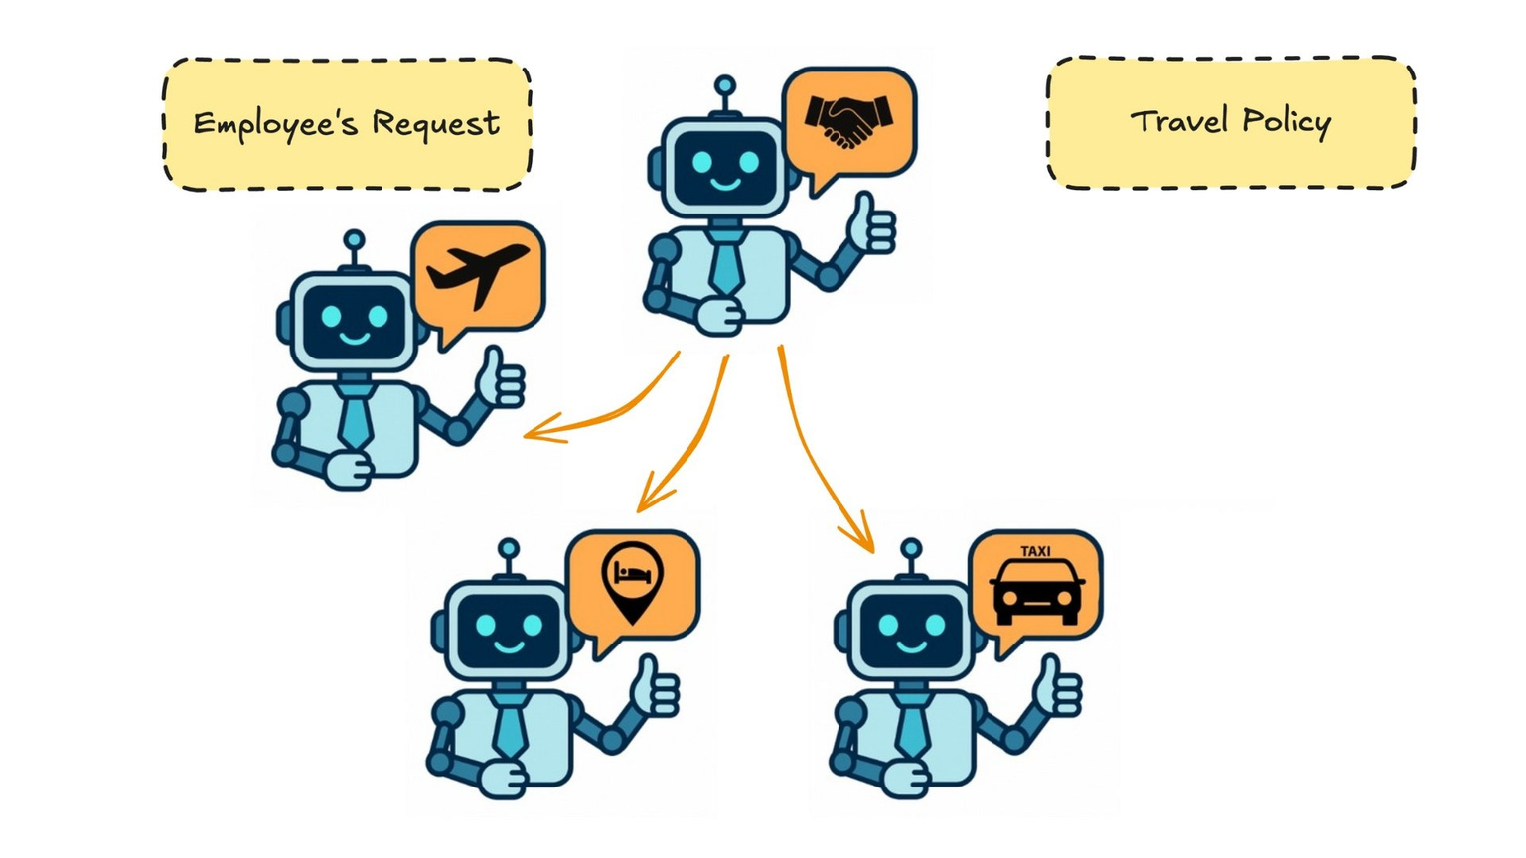
Example: Corporate travel
BUILDING SCALABLE AGENTIC SYSTEMS

Slide 23
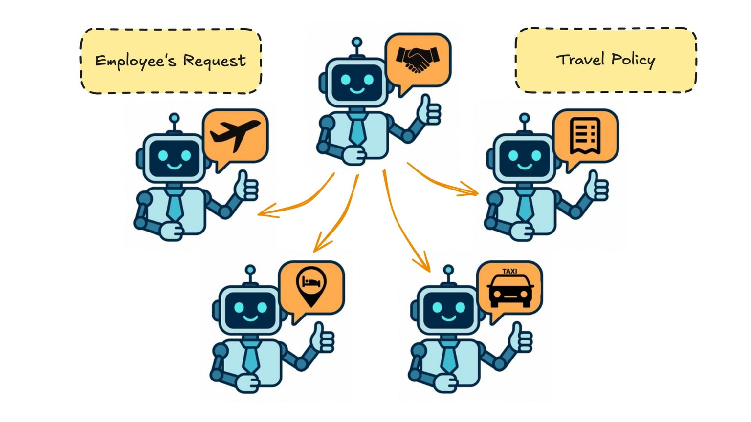
Example: Corporate travel
BUILDING SCALABLE AGENTIC SYSTEMS

Slide 24
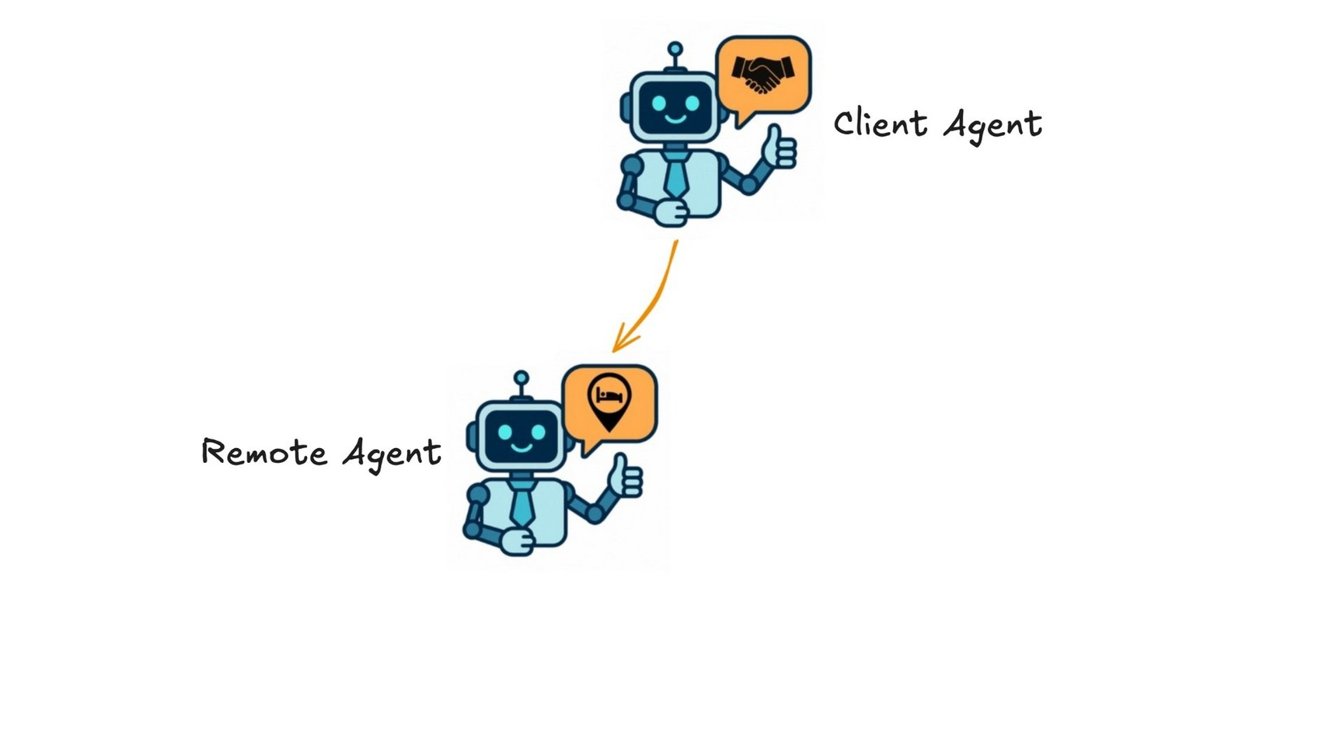
Agent-to-Agent (A2A)
BUILDING SCALABLE AGENTIC SYSTEMS

Slide 25
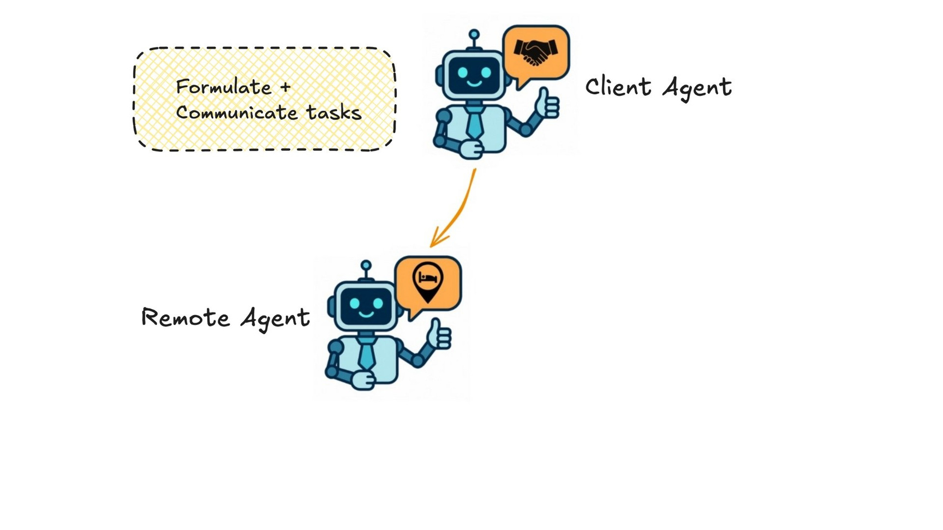
Agent-to-Agent (A2A)
BUILDING SCALABLE AGENTIC SYSTEMS

Slide 26
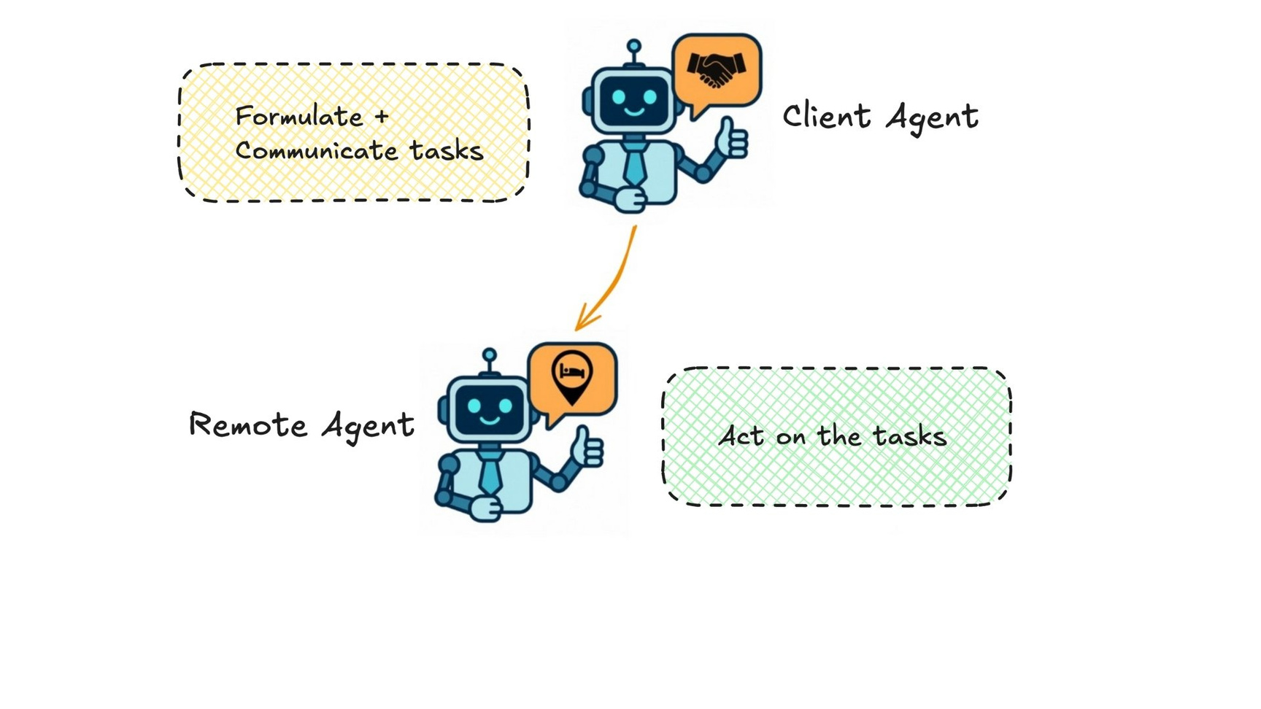
Agent-to-Agent (A2A)
BUILDING SCALABLE AGENTIC SYSTEMS

Slide 27
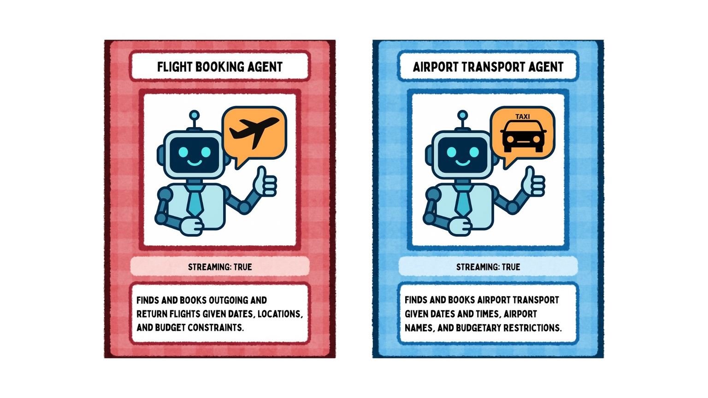
Agent cards
BUILDING SCALABLE AGENTIC SYSTEMS

Slide 28
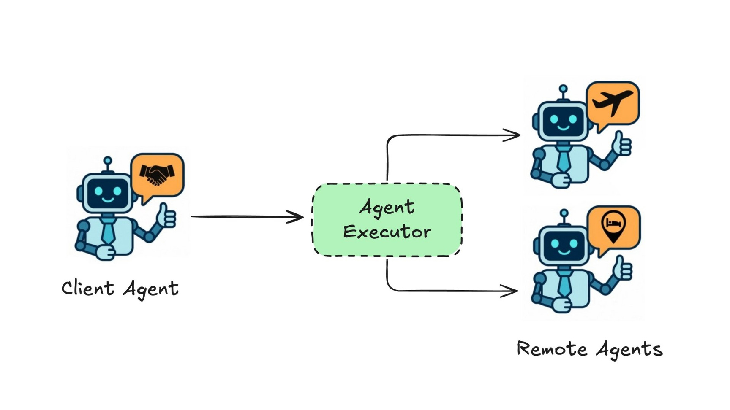
BUILDING SCALABLE AGENTIC SYSTEMS

Slide 29
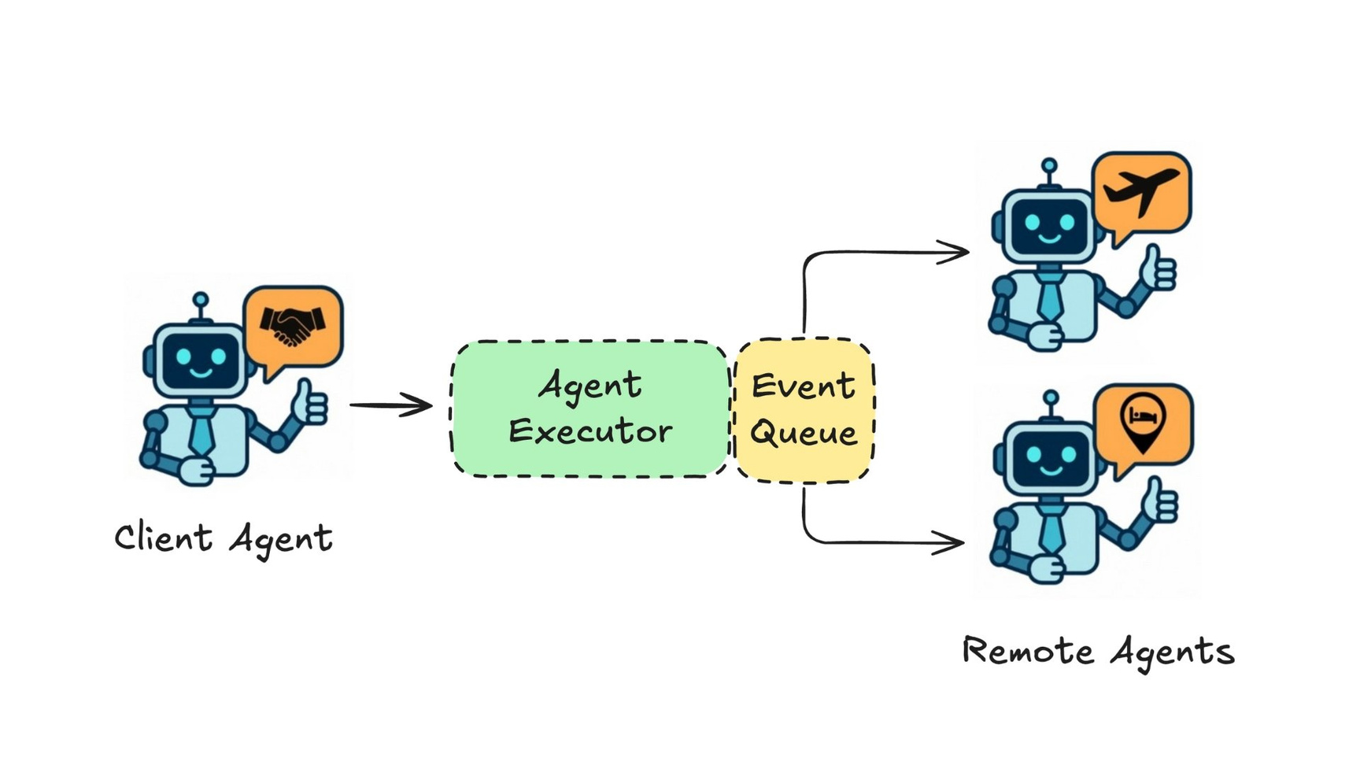
BUILDING SCALABLE AGENTIC SYSTEMS

Slide 30
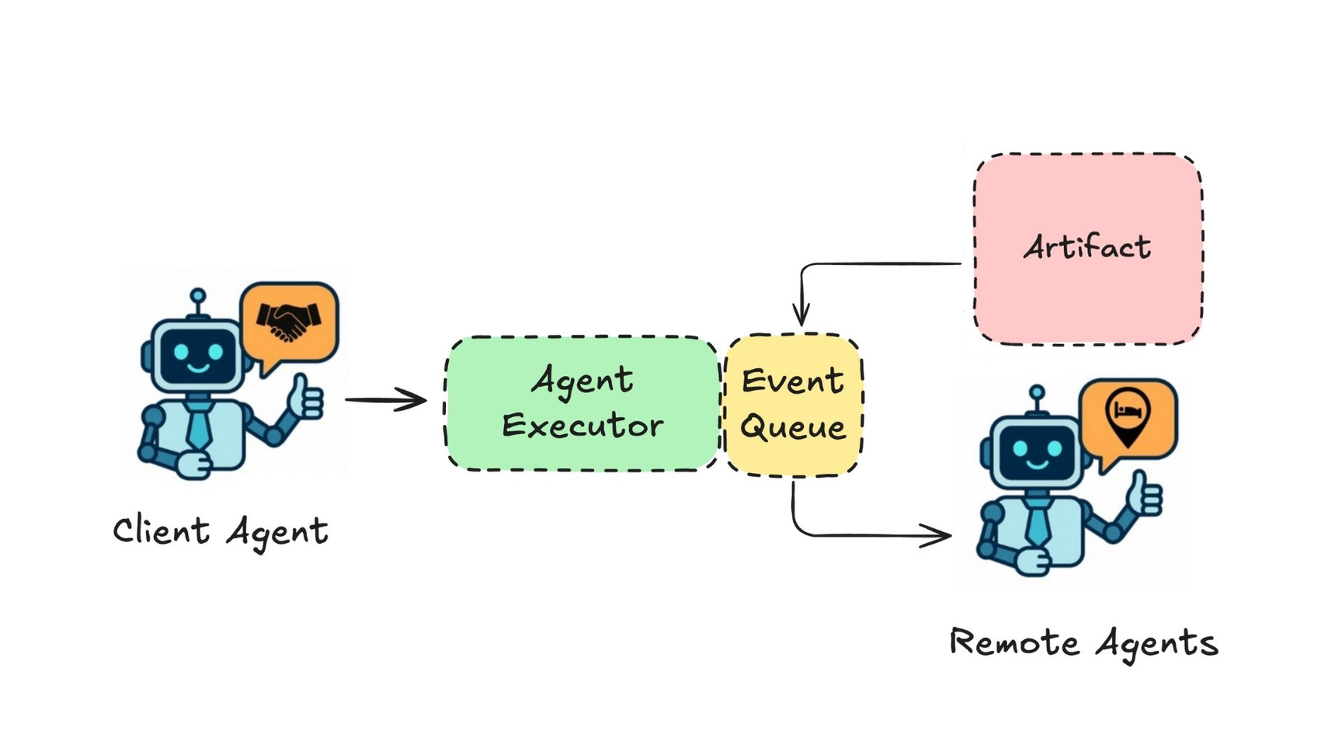
BUILDING SCALABLE AGENTIC SYSTEMS

Slide 31
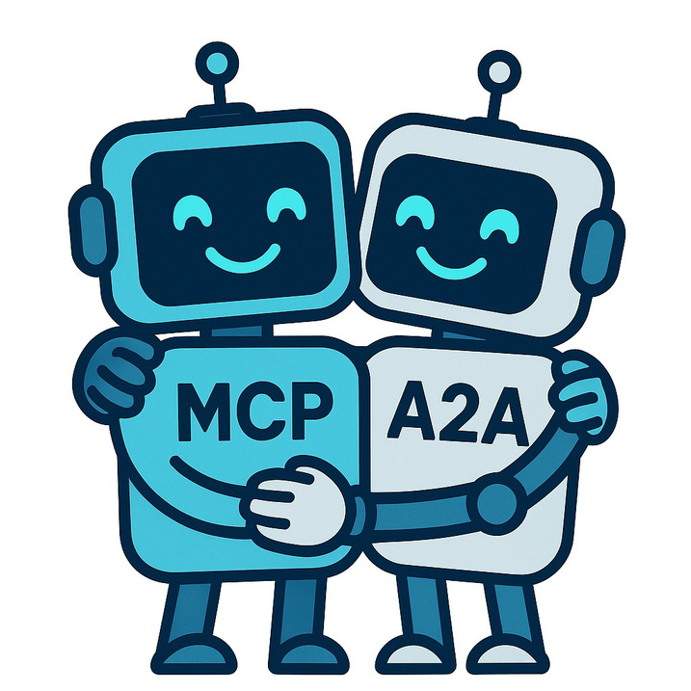
MCP and A2A
1
Image generated with GPT-4o
BUILDING SCALABLE AGENTIC SYSTEMS

